Slide 1

Tkinter
Event.
אירוע.
Events and Bindings
widget.bind(event, handler)
Keyboard
import tkinter as tk
def event_info(event):
pass
root = tk.Tk()
root.bind("<KeyPress>", event_info)
root.mainloop()

Slide 2
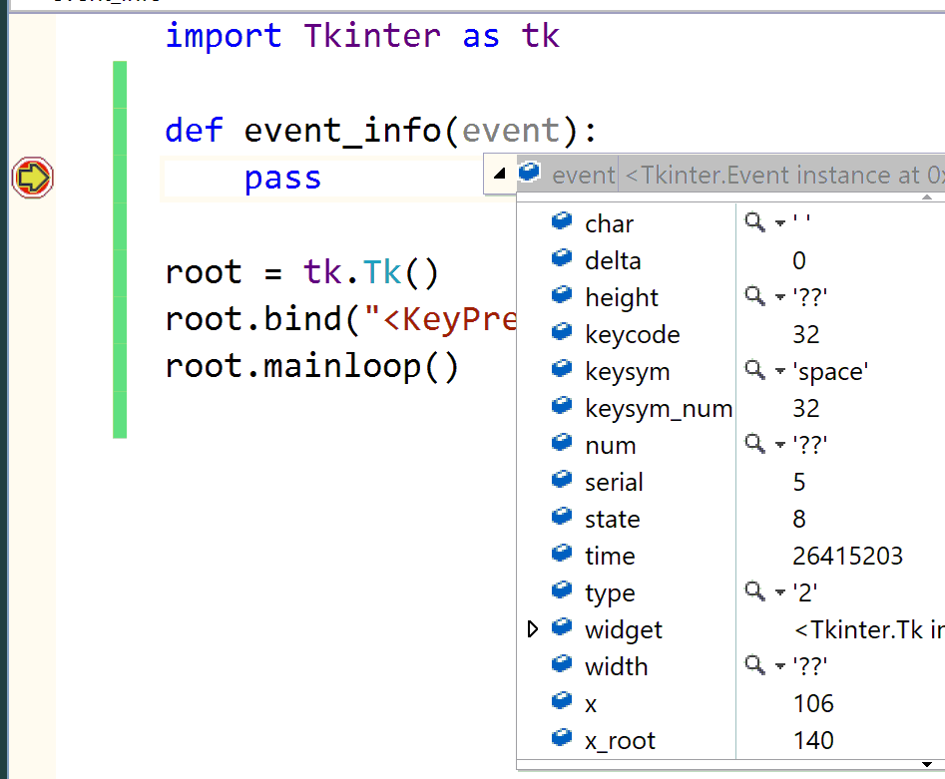
Tkinter

Slide 3
Tkinter
from tkinter import *
tk = Tk()
def event_info(event):
print (dir(event))
tk.bind("<KeyPress>", event_info)
tk.mainloop()
0
1
2
3
4
5
6
['__doc__', '__module__', 'char', 'delta', 'height', 'keycode', 'keysym', 'keysym_num', 'num', 'serial', 'state', 'time'
, 'type', 'widget', 'width', 'x', 'x_root', 'y', 'y_root']

Slide 4
Tkinter
Events and Bindings
import tkinter as tk
def event_info(event):
k=dir(event)
key=getattr(event,k[6])
root.title(key)
root = tk.Tk()
root.bind("<KeyPress>", event_info)
root.mainloop()

Slide 5
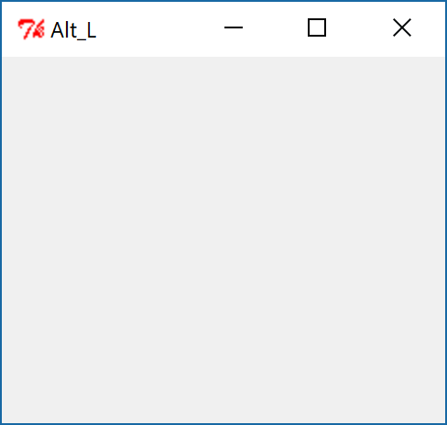
Tkinter

Slide 6
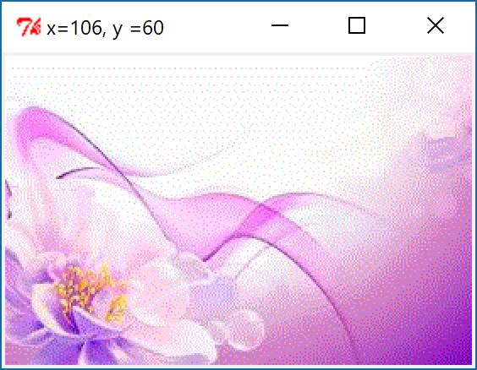
Tkinter
Mouse
import tkinter as tk
def callback(event):
root.title('x={0:2d}, y ={1:2d}'.format(event.x, event.y))
root = tk.Tk()
bg_image = tk.PhotoImage(file ="bg.gif")
lbl = tk.Label (root, image = bg_image)
lbl.pack()
lbl.bind("<Button-1>", callback)
root.mainloop()

Slide 7

Tkinter
Mouse
import tkinter as tk
def callback(event):
root.title('x={0:2d}, y ={1:2d}'.format(event.x, event.y))
root = tk.Tk()
bg_image = tk.PhotoImage(file ="bg.gif")
lbl = tk.Label (root, image = bg_image)
lbl.pack()
lbl.bind("<Motion>", callback)
root.mainloop()

Slide 8
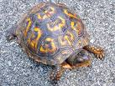
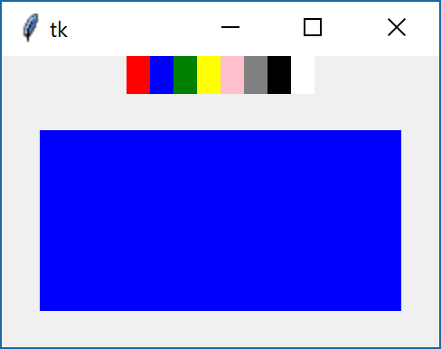
Tkinter
Arrange the widgets according to the picture.
Easy

Slide 9
Tkinter
Arrange the widgets according to the picture.
Easy
import tkinter as tk
def color_selection(event):
frame_canvas['bg']= event.widget._name
def colors():
names_colors = ['red', 'blue', 'green','yellow', 'pink', 'gray','black', 'white']
for i in range(len(names_colors)):
lbl = tk.Label (frame_colors, name=names_colors[i], bg = names_colors[i], width =1, height = 1)
lbl.pack(side = 'left')
lbl.bind("<Button-1>", color_selection)
root = tk.Tk()
frame_colors = tk.Frame(root)
frame_colors.pack()
frame_canvas = tk.Frame(root,width =200, height = 100)
frame_canvas.pack(padx=20, pady=20)
colors()
root.mainloop()

Slide 10
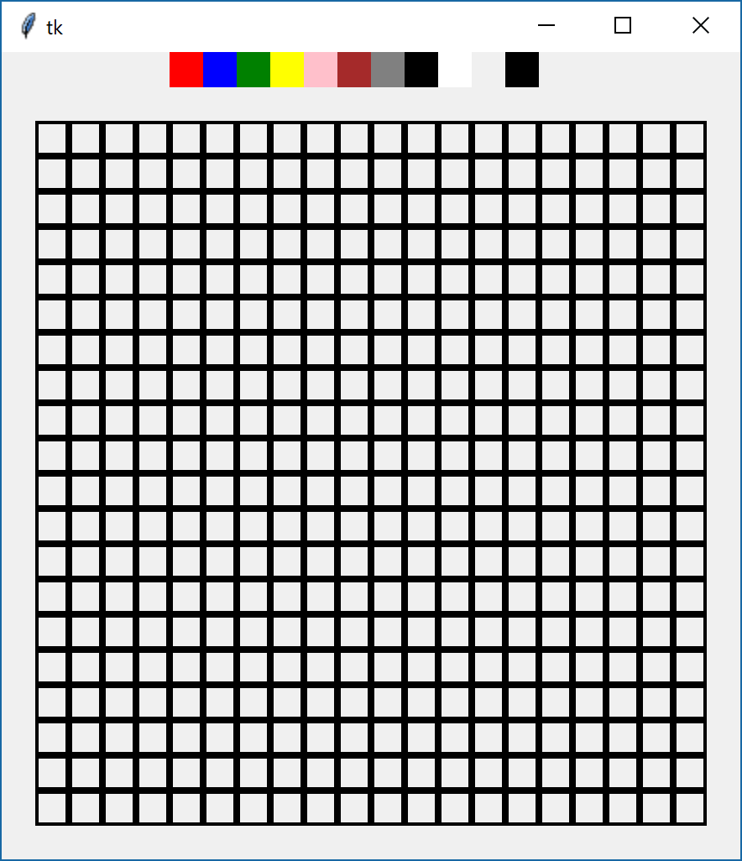
Tkinter
Arrange the widgets according to the picture.
Medium

Slide 11
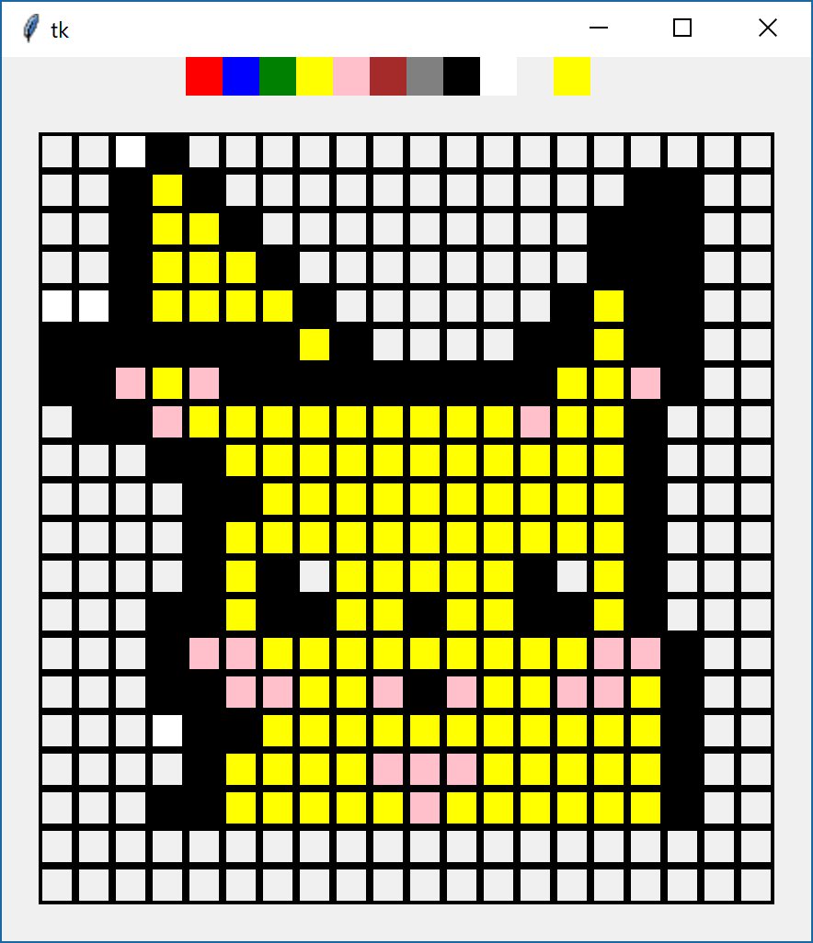
Tkinter
Arrange the widgets according to the picture.
Hard

Slide 12
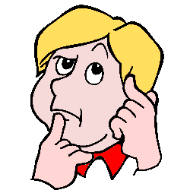
Tkinter
Arrange the widgets according to the picture.
יצירתיות

